Slide 1
App Service Web Apps
Damir Dobric daenet GmbH

Slide 2
Agenda
Web App creation
Language Support
Deployment
Source Control Integration
Scale
Web Jobs
Site Slots
Traffic Manager
Backup
Hybrid Connections
Redis Cache

Slide 3
Azure App Service

Slide 4


Azure App Service Build and scale great cloud apps
Web Apps
Mobile Apps
Logic Apps
API Apps

Slide 5
App Service - one integrated offering
Web Apps
Mobile Apps
Web apps that scale with your business
Build Mobile apps for any device
LOGIC Apps
API Apps
Automate business process across SaaS and on-premises
Easily build and consume APIs in the cloud

Slide 6
Develop apps with…
.NET | Node.js | PHP | Python | Java

Slide 7
Benefits of App Services
Automatic OS patching
Enterprise-grade security
High availability
Automated scale out/in
Built-in load balancing
Supports many languages and platforms
.NET, Node.js, Python, Ruby and many more
Easy continuous deployment
Continuous delivery from third-party source control providers
Built-in Git repo

Slide 8



Web Apps
Logic Apps
Mobile Apps
Administration App
Customer site
Order Completed
Customer App
http
SQL
API Apps

Slide 9
Web Apps

Slide 10
Full capability set available including:
.NET, Node.js, Java, PHP, and Python
WebJobs for long running tasks
Integrated VS publish, remote debug…
CI with GitHub, BitBucket, VSO
Auto-load balance, Autoscale, Geo DR
Virtual networking and hybrid connections
Site slots for staged deployments
Web Apps
Web apps run as-is
no changes required

Slide 11
App Service Web App
Web Site
Monaco
MSDeploy
Build/Upload Your Own
Kudu
Web Jobs
Gallery
Public Site Extensions
Private Site Extensions
Azure App Service Web App

Slide 12
API Apps

Slide 13
Easily use cloud or custom APIs:
Dozens of built-in APIs for popular SaaS
An ecosystem of APIs for any need
Create and publish custom, reusable APIs
Visual Studio tooling with one click publish and remote debugging
Automatic client SDK generation for many languages
Api Apps
Create, consume and
host APIs more easily

Slide 14
Benefits of API Apps
Bring your API as-is
.NET Web API
Node.js + Express
Java
PHP
Many other technologies
Connect easily to SaaS platforms

Slide 15
API Apps addresses key pains around building and consuming APIs
Build your API
Consume APIs
Web Apps++: Bring you API as is in your language of choice
API discovery
SDK generation
SSO, handled by server
Authentication, built-in to mobile and web SDKs
Expose enterprise APIs
Microservice style
Metadata contract
SSO
Simple access control
Gallery – public & organization

Slide 16
Demo: Creating an API App

Slide 17
Demo: - Create some ASP.NET or ASP.NET API App - Deploy it to Azure
https://docs.microsoft.com/en-us/azure/app-service/app-service-web-get-started-dotnet

Slide 18
App Service Web App Architecture
Deployment
Server(s)
File Server
Publish Endpoint
Blob Storage
Application Database
Frontend (IIS)
Microsoft Azure
Load Balancer
Metering
Runtime Database
API Endpoint

Slide 19
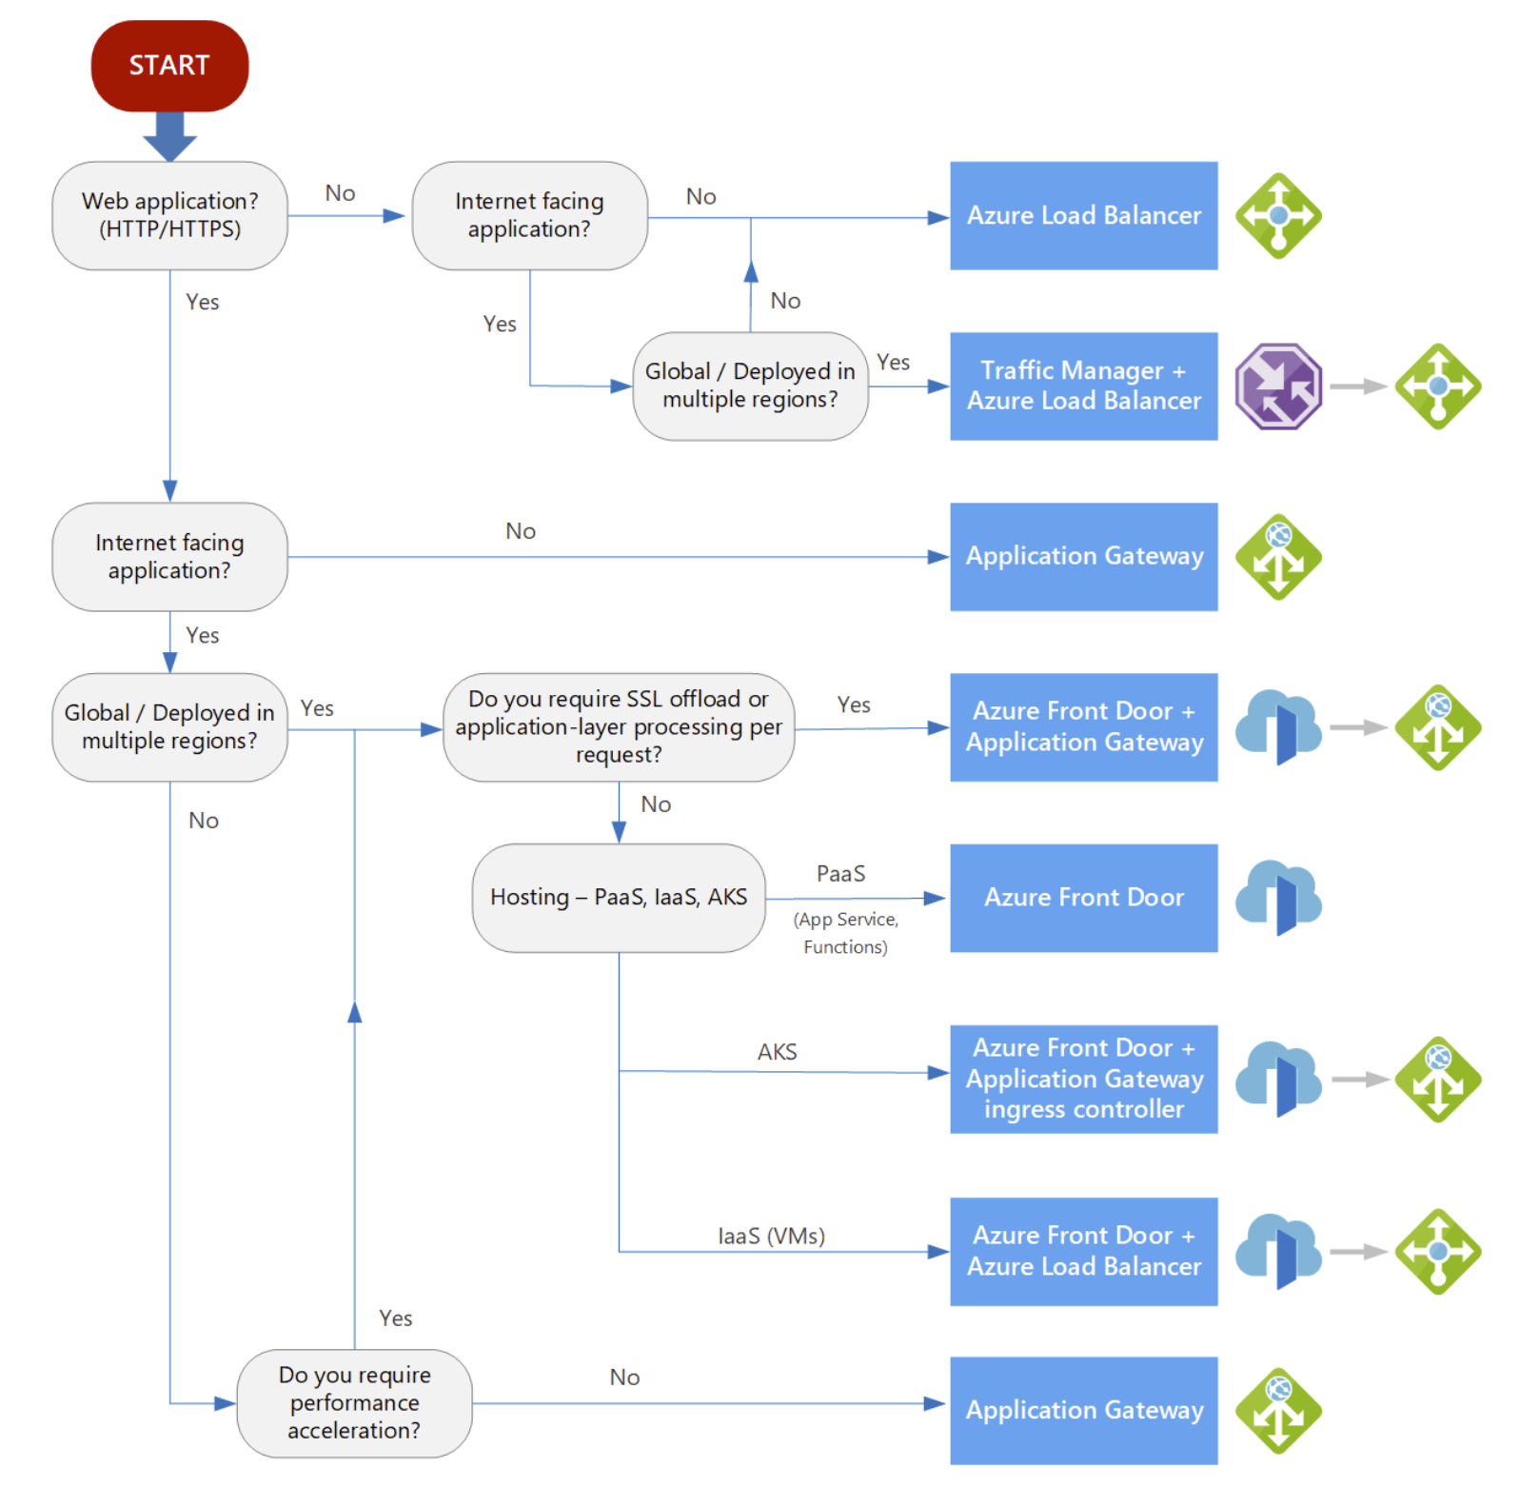
Load Balancers in Azure
https://docs.microsoft.com/en-us/azure/architecture/guide/technology-choices/load-balancing-overview

Slide 20
App Service with Application Gateway
https://docs.microsoft.com/en-us/azure/application-gateway/create-web-app
App Service behind Front Door
https://docs.microsoft.com/en-us/azure/frontdoor/quickstart-create-front-door
Load Balancers in Azure
https://docs.microsoft.com/en-us/azure/architecture/guide/technology-choices/load-balancing-overview

Slide 21
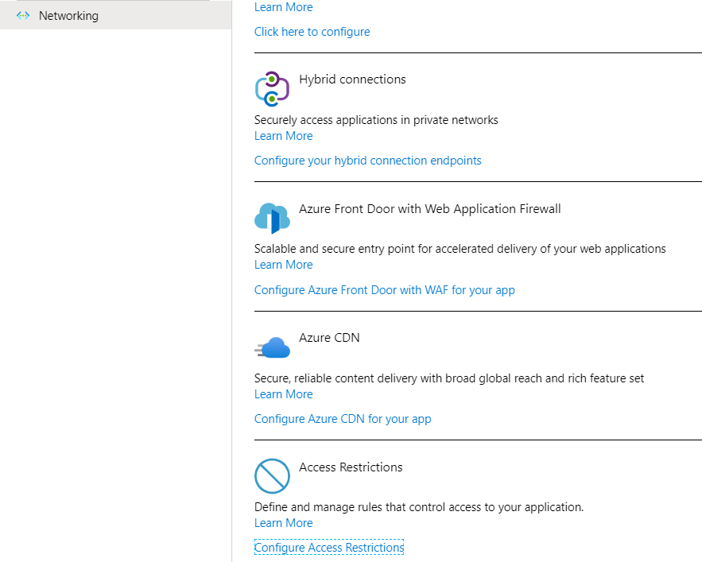

Slide 22
Chose the right Compute Service
Choose an Azure compute service - Azure Architecture Center | Microsoft Learn

Slide 23
WebJobs

Slide 24






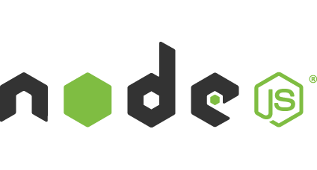

Light-weight CPU Intensive Tasks
run.cmd, run.bat
run.exe
run.ps1
run.sh
run.php
run.py
run.js
Job Type:
On-Demand, Scheduled, Continuous
Scale:
Singleton, Multi-instance
WebJobs SDK Feature:
BlobTrigger, TableTrigger, QueueTrigger, ServicebusTrigger
Deployment:
Portal, Visual Studio, CLI, Git

Slide 25

WebJobs
Web App

Slide 26
WebJobs
Web App

Slide 27
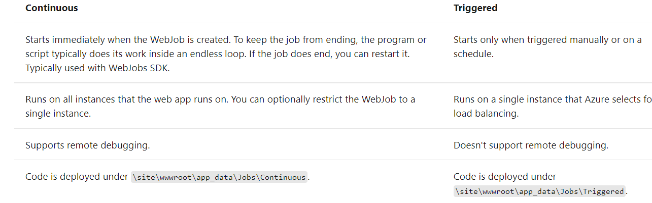
WebJob Types

Slide 28
Bindings and Triggers
Azure CosmosDB trigger
Event Hubs trigger
Queue storage trigger
SendGrid binding
Service Bus trigger
https://docs.microsoft.com/en-us/azure/app-service/webjobs-sdk-how-to

Slide 29
Demo: WebJobs
VS: https://docs.microsoft.com/en-us/azure/app-service/webjobs-sdk-get-started
Portal: https://docs.microsoft.com/en-us/azure/app-service/webjobs-create#CreateOnDemand
Use the Azure Storage Emulator for development and testing (deprecated) | Microsoft Docs

Slide 30
AutoScale

Slide 31
AutoScale
Web App

Slide 32
AutoScale
Web App

Slide 33
AutoScale
Web App

Slide 34
App Service Environment

Slide 35
App Service Environment (ASE)
New Premium Tier Feature
Dedicated compute resources and network resources
Increased Scaling Options
Directly created in a Virtual Network
Support all Web App features and capabilities
Support Web, Mobile and API Apps
Global Scale

Slide 36
Conceptual Model
App Service Plan
App Service Plan
App Service App
App Service App
App Service App
App Service App
App Service App
App Service App
SKU: Premium (# of sites, storage, slots…)
Compute Resource: P4 ( 8 cores, 14 GB memory)
Scale: 8
SKU: # of sites, storage, slots…
Compute Resource: cores, memory
Scale: number of instances
Note: For App Service Environment the SKU will always be Premium
Notes:
Speaker notes:
Explain how ASE differ from multi-tenant App Service using App Service Plan.

Slide 37
Application Insights

Slide 38
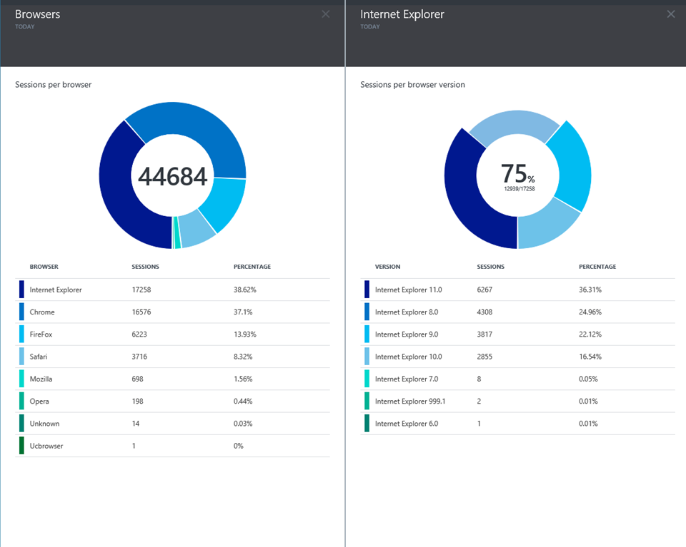
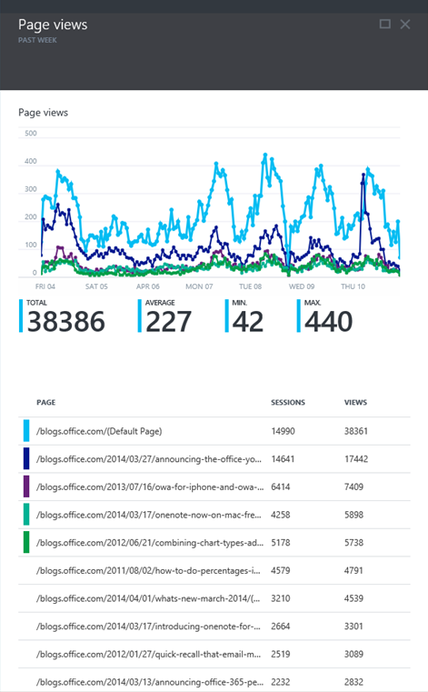
Application Insights
Application Insights

Slide 39
Try App Service: Web Apps today
https://tryappservice.azure.com
Ask Questions:
Twitter:
Email
Public forum:

Slide 40
Q&A

Slide 41


Get started
Visit azure.microsoft.com

